Slide 1

Department of Information Technology
NBA Accredited A.P. Shah Institute of Technology G.B.Road, Kasarvadavli, Thane(W), Mumbai-400615 UNIVERSITY OF MUMBAI Academic Year 2020-2021

Slide 2
A Project Report on Online Certificate Generation & Verification using Blockchain Framework
Submitted in fulfillment of the degree of Bachelor of Engineering(Sem-8) in INFORMATION TECHNOLOGY By Prasad Jadhav (17104003) Rutwik Gaikwad(17104074) Aseem Godambe(17104058) Under the Guidance of
Prof. Kiran Deshpande

Slide 3
1.Project Conception and Initiation

Slide 4
1.1 Abstract
There are many cases reported of certificate forgery everyday and many of them go undetected.
In this project we focus on Ethereum Blockchain as it is immutable, transparent,scalable, and also cost-effective.
Universities would be able to generate their own certificates on the web portal itself.
Each generated certificate would be allotted to the respective student within the system. Each certificate would be given a unique hash code so that it could be verified easily and there would be no scope of duplication.
The authentication and verification would be done on the same web portal.
To sum up, this system would save time and efforts that are required to verify a certificate manually and would result in an effective, secure way to generate certificates.

Slide 5
1.2 Objectives
To create a central portal for all the Universities/ Institutions.
To provide throughout data security by using Ethereum blockchain and also protecting certificates by allotting a unique hash code to each and every certificate.
To make it possible for Universities/Institutions to generate certificate on the portal itself.
To make the portal as simplistic as possible.
To make the system cost effective.

Slide 6
1.3 Literature Review
Shanmuga Priya R,Swetha N ‘Online Certificate Validation Using Blockchain.’
Nitin Kumavat, Swapnil Mengade, Dishant Desai, Jesal-Varolia ‘Certificate Verification System using Blockchain’

Slide 7
1.4 Problem Definition
To develop an application to generate certificates online, the application should also be able to authenticate and verify the the certificate on a central online portal.

Slide 8
1.5 Scope
Can be used to generate the certificate online.
Can be used to authenticate certificates on a centralized online portal.
Can be used to verify certificates on a central online portal.
Can be used for easy access of any certificate from anywhere, anytime.

Slide 9
1.6 Technology stack
React
MetaMask
Ganache
Truffle
Etherium
Node JS
Postgresql

Slide 10
1.7 Benefits for environment & Society
Blockchain is a completely online system and can be accessed easily from around the world.
Reduces the usage of physical certificates that are vulnerable to damage over a long period.
The system eliminates the risk of misplaced certification or late delivery of certificates.
Having a visible digital footprint or online identity will give an added advantage to students to help crack any interview with ease.

Slide 11
2. Project Design

Slide 12
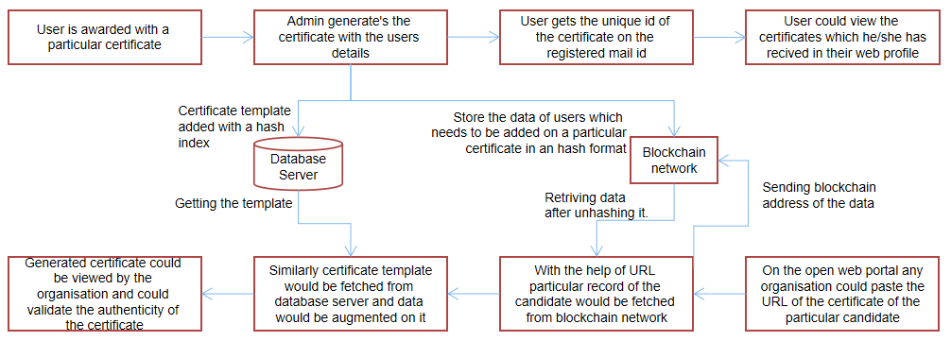
2.1 Proposed System

Slide 13
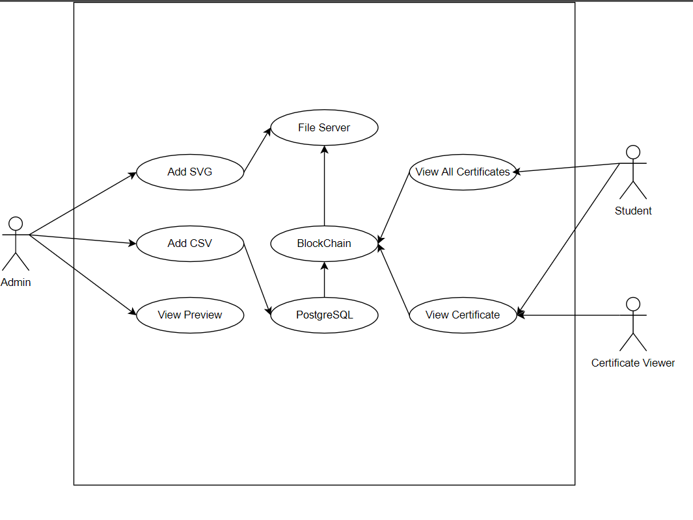
2.2 Use case diagram:

Slide 14
2.3 Description Of Use Case
Here, in the above diagram, admin is the actor and is able to add certificates in the form of SVG and CSV data, preview sample certificate before uploading data to Blockchain.
The File Server and Postgresql are included by the Add SVG and Add CSV entities respectively.
Student is another actor

Slide 15
3. Implementation

Slide 16


Slide 17
4. Result

Slide 18
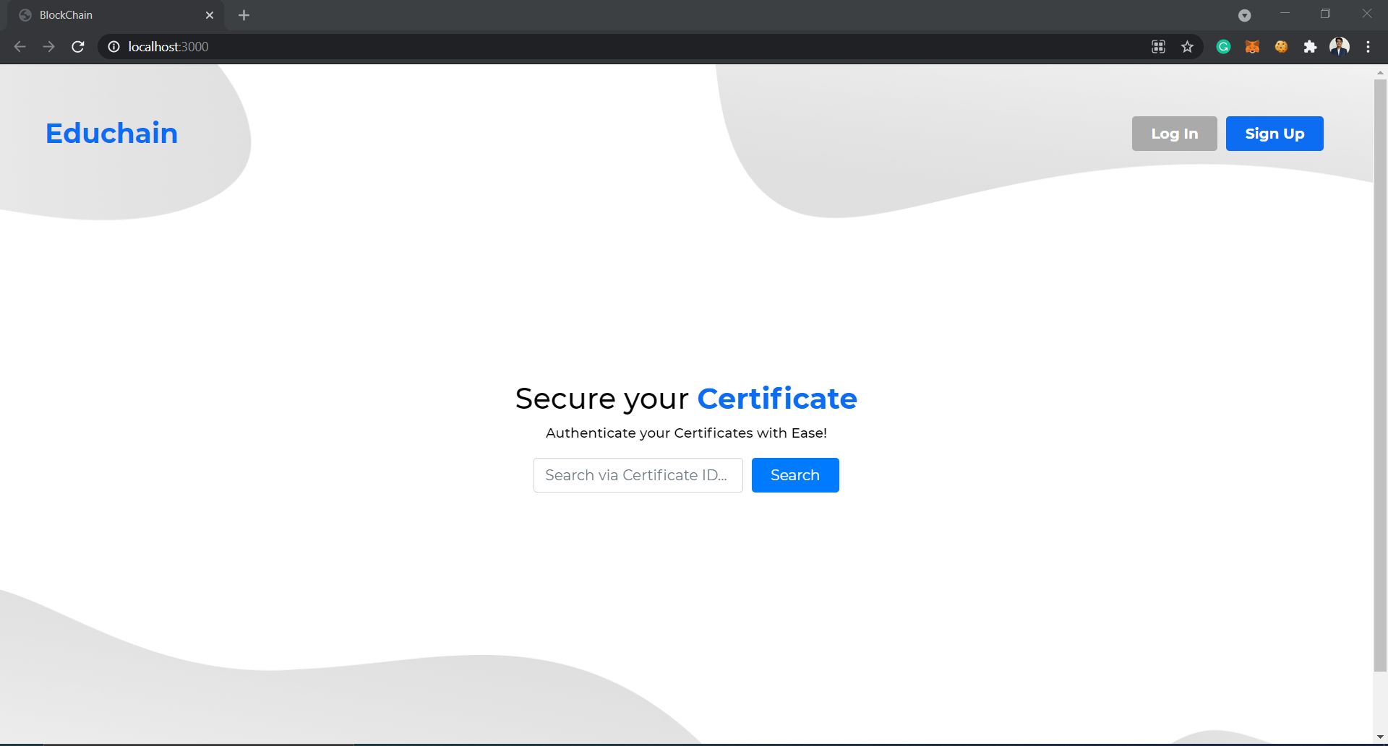
Home Screen:

Slide 19
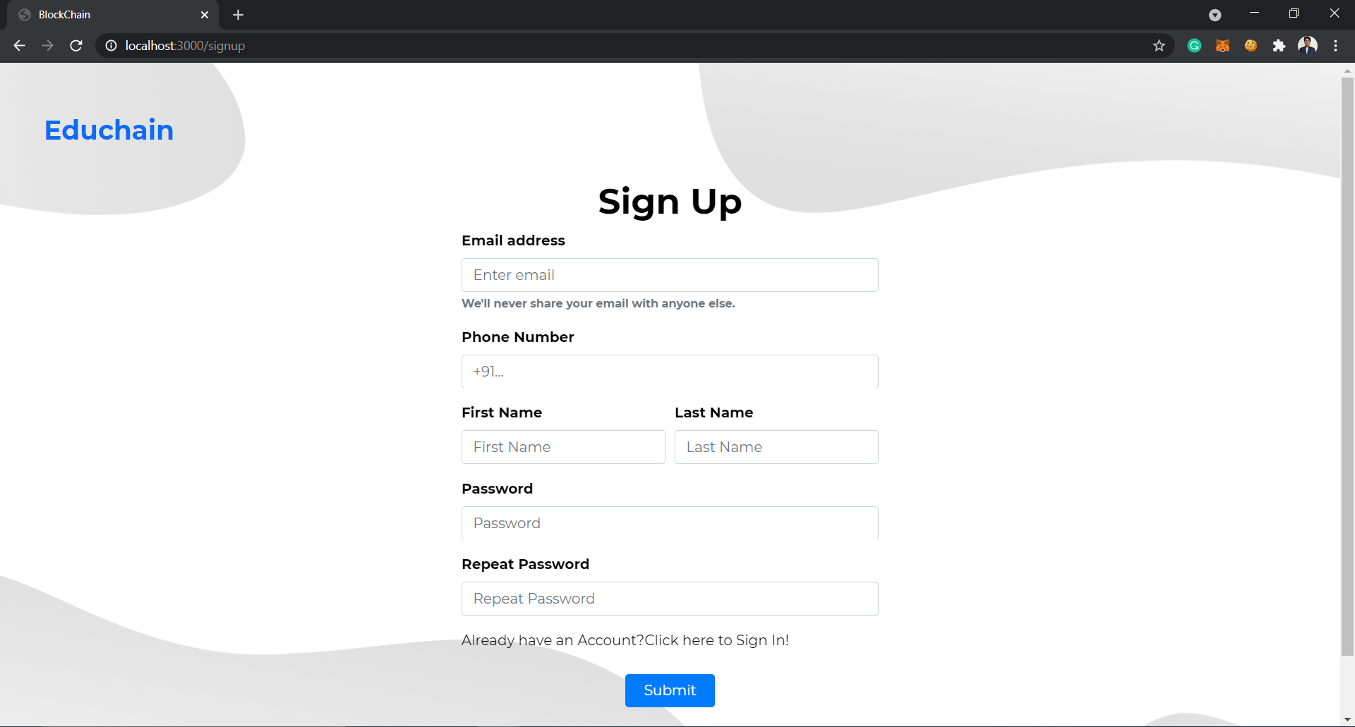
Registration Page:

Slide 20
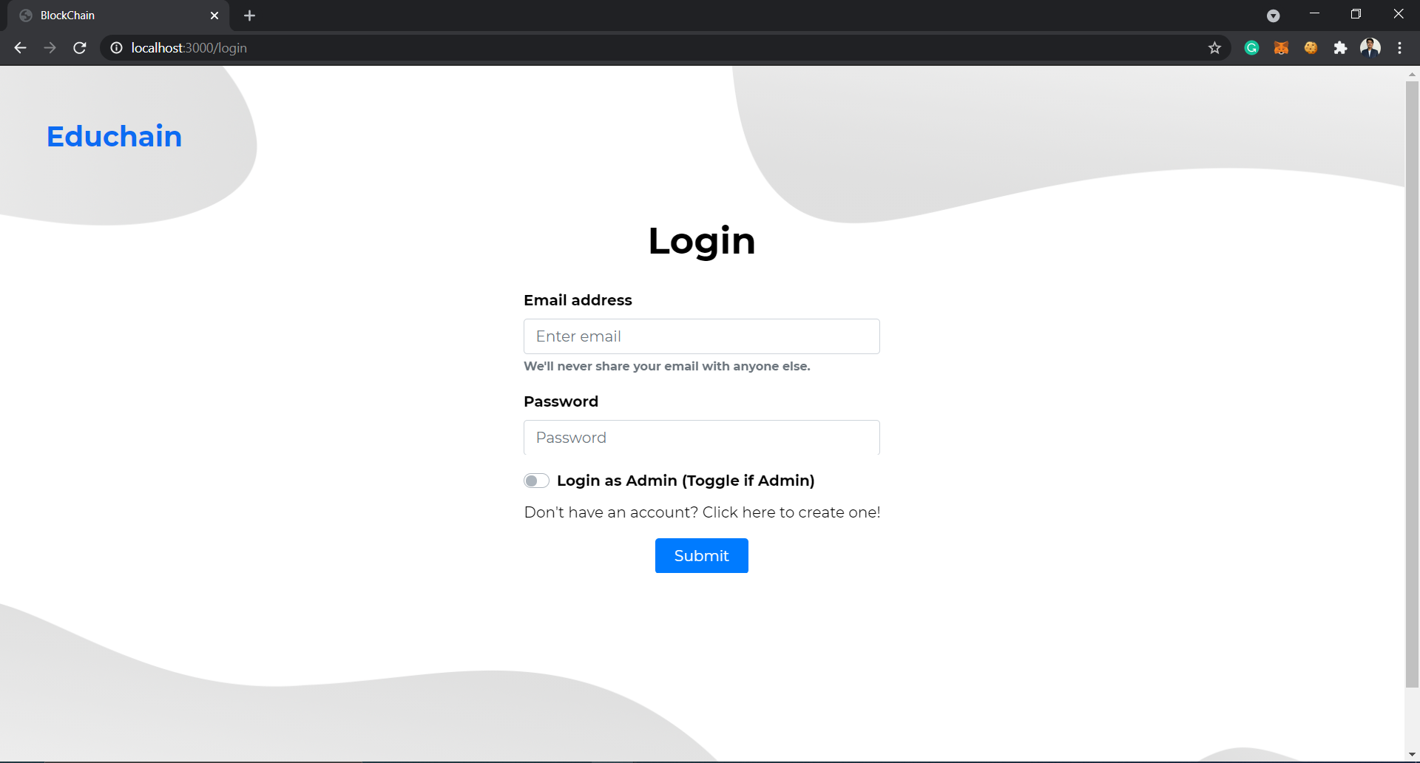
Login Page:

Slide 21
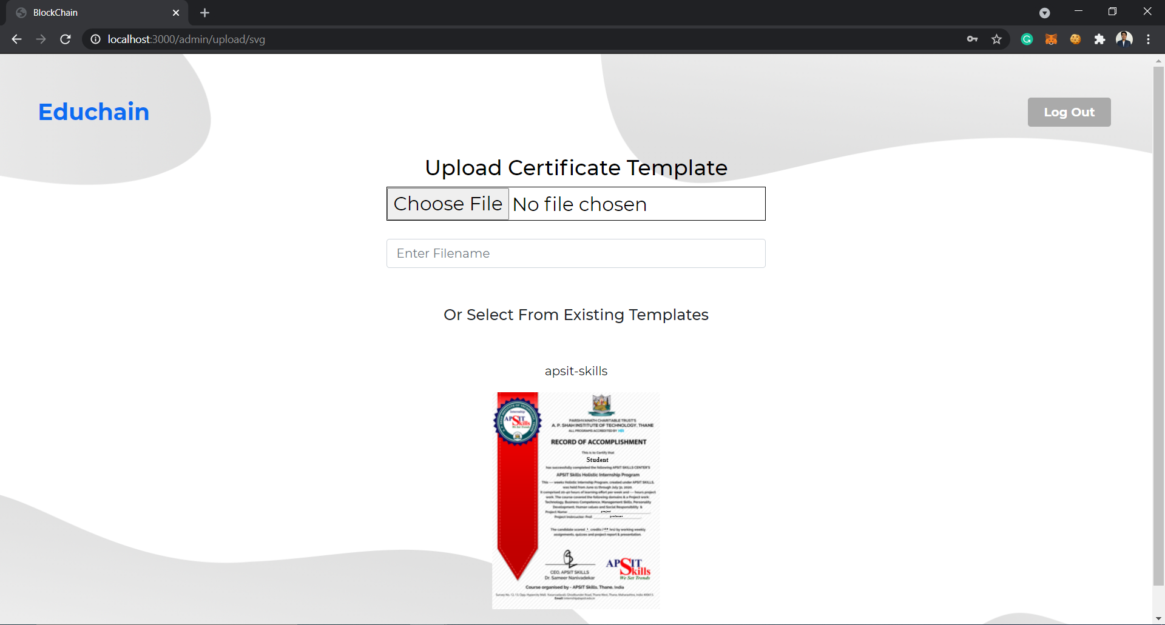
Admin portal to add certificate template:

Slide 22
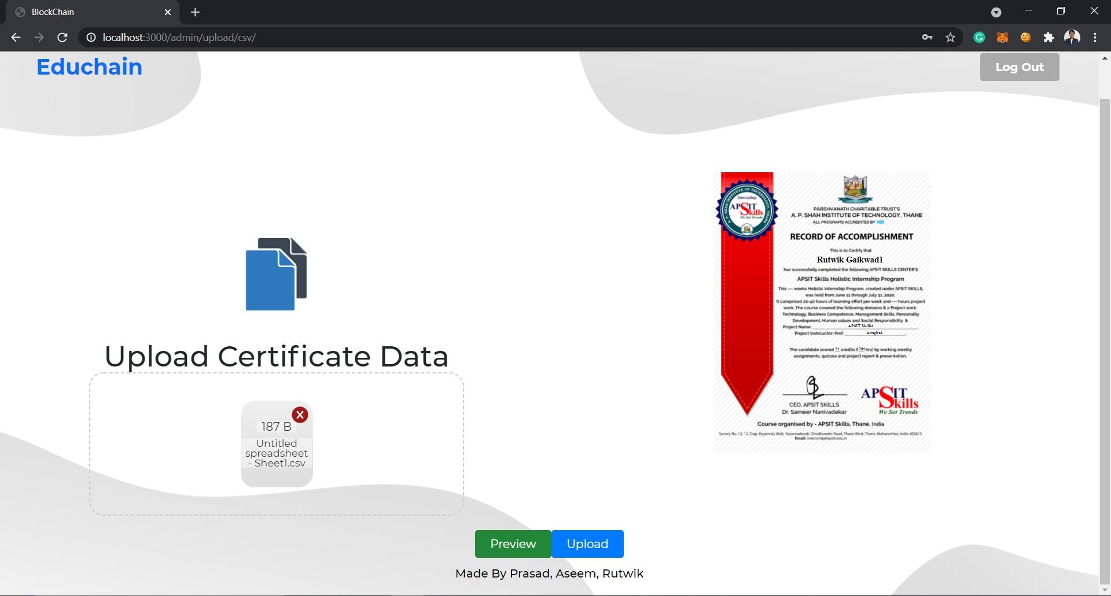
Admin portal to add CSV file and view preview of the certificate:

Slide 23
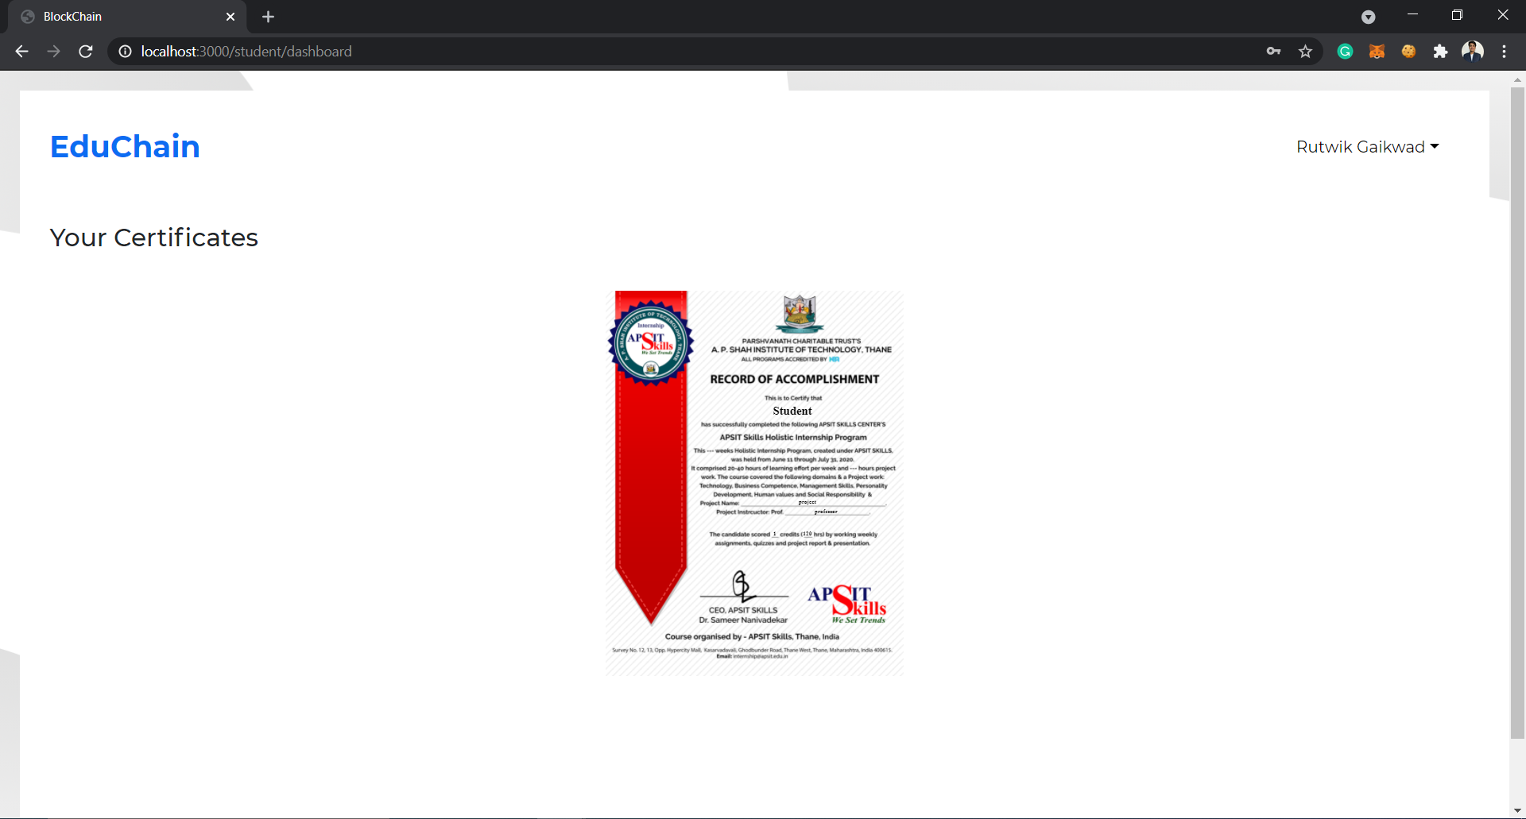
Student dashboard to view his/her certificates:

Slide 24
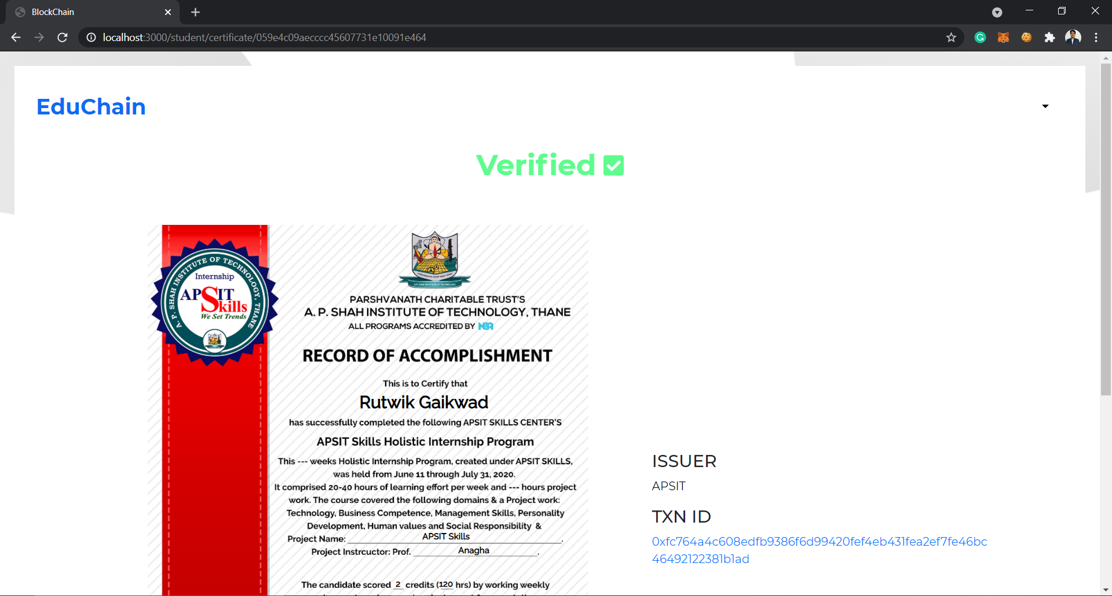
Verified certificate:

Slide 25
6. Conclusion and Future Scope

Slide 26
6.1 Conclusion
In this project, we have successfully proposed a system where blockchain technology can be used to store and retrieve certificate data. The project will help companies issue certificates securely through Blockchain and can be verified by anyone with the unique link/code to each certificate. The system uses the concept of SVG templates for the certificates which would be stored on a local server and to store data over the blockchain for secure and reliable storage. This will minimize the cost of storing the entire certificate on the blockchain network. Storing only the data of the certificate will minimize cost and thereby turn out to be cost-efficient. The only drawback of this system is that the template of the certificate needs to be properly created with the SVG’s textarea ID to match with the header of the CSV file. Only a properly crafted SVG and CSV pair will result in proper certificate generation through Blockchain.

Slide 27
6.2 Future Scope
Currently, the certificate template which is stored on local file storage is the weakest link in the system. The template relies on the security of the File System used. The use of IPFS - InterPlanetary File System can secure the certificate template stored thereby adding to the security of the system.
IPFS has the capacity to store files over Blockchain allowing secure storage and retrieval of the certificate template.
The system can be further extended to store other online documents of importance to ensure the integrity of data and documents being stored securely.

Slide 28
References
https://www.ijana.in/papers/37.pdf
http://ijraset.com/fileserve.php?FID=20914
https://www.blockcerts.org/
https://www.blockchain-council.org/blockchain/document-verification-system-using-blockchain/

Slide 29
Paper Publication
Paper entitled “Online Certificate Generation & Verification using Blockchain Framework” is presented at “ICSCS 2021 : International Conference on Soft Computing For Security Applications” by Prasad Jadhav, Rutwik Gaikwad, Aseem Godambe and Kiran Deshpande.

Slide 30
Thank You

